Slide 1
Migrating models from other solvers to use the Gurobi solver
Thank you for joining us. We’ll be starting shortly.

Slide 2
Migrating models from other solvers to use the Gurobi solver
Renan Garcia, Ph.D., Gurobi Optimization
David Nehme, Ph.D., Abremod

Slide 3

Renan Garcia, Ph.D.
Optimization Support Engineer at Gurobi Optimization
Ph.D. in Industrial and Systems Engineering, Georgia Tech
Expert in optimization modeling and software development
Over a decade of experience implementing decision support systems

Slide 4
David Nehme, Ph.D.
Todo: add David's bio, change pic?

Slide 5
Agenda
Switching is easier than you may think
Common migration scenarios
Migrating from OPL
Migration library for CPLEX Concert API
Best practices, limitations and considerations

Slide 6
Switching is Easier Than You May Think

Slide 7
Key Migration Issues
Building the model
How do I build my optimization model?
Do I build it one constraint at a time, or do I build an entire constraint matrix?
Setting solver parameters
What solver parameters do I change?
What effects are these changes intended to produce?
Computing and extracting the solution
How do I extract the solution produced by the solver?
Am I looking for an optimal solution, or just a good feasible solution?

Slide 8
Interfacing with Gurobi
Command-Line Tool
Full-featured Interactive Shell
Matrix-oriented APIs
C, MATLAB, R
Object-oriented APIs
C++, Java, .NET, Python
Modeling systems
Commercial: AIMMS, AMPL, Frontline Solvers, GAMS, MPL, …
Free: CMPL, JuliaOpt, OSI, PuLP, PYOMO, SolverStudio, YALMIP, …
Other languages possible, but not officially supported

Slide 9
Do-It-Yourself Resources on gurobi.com
Switching guidance: https://www.gurobi.com/resources/switching-to-gurobi/switching-overview
Documentation: https://www.gurobi.com/documentation/
Quick Start Guides
Reference Manual
APIs
Attributes
Parameters
Tuning
…
Example Tour
22 functional examples
Seminars and videos: https://www.gurobi.com/resources/seminars-and-videos/seminars-videos

Slide 10
Common Migration Scenarios

Slide 11
Scenario 1: Migrating with Model Files
Example: performance testing
Export model file with virtually no changes needed to existing code
Gurobi supports several file formats (MPS, LP, …)
Export guidance: https://www.gurobi.com/resources/switching-to-gurobi/exporting-mps-files-from-competing-solvers
Use Gurobi Command-Line Tool to solve the model
Usage: gurobi_cl [parameters] filename
Ex: gurobi_cl TimeLimit=3600 misc07.mps
"Quick-and-dirty" approach
Limited ability to interact with solver (parameters only)
For more control, try Gurobi Interactive Shell

Slide 12
Gurobi Parameters
Control algorithmic behavior
Defaults validated against large internal test set of models
Termination criteria
Ex. TimeLimit, SolutionLimit
Tolerances
Ex. MIPGap, BarConvTol
Simplex and barrier
Ex. Method, Crossover
MIP and MIP cuts
Ex. MIPFocus, ImproveStartTime
MIP cuts
Ex. Cuts, GomoryPasses
Tuning and distributed algorithms
Ex. TuneJobs, WorkerPool
General
Ex. Presolve, OutputFlag

Slide 13
Scenario 2: Using a Modeling System
Example: model is written in AMPL
With independent modeling systems, migrating is extremely easy
Obtain license
Set solver to Gurobi
Ex: in AMPL model file, add
option solver gurobi_ampl;
Convert parameter settings
Ex: in AMPL model file, add
option gurobi_options 'mipfocus 1';

Slide 14
Gurobi Python Environment
High-level optimization modeling constructs embedded in Python programming language
Combines expressiveness of a modeling language with the power and flexibility of a programming language
Design goals:
Require minimal programming skills to get started
Bring "feel" of a modeling language to the Python interface
Allow for code that is easy to write and maintain
Maintain unified design across all of our interfaces
Remain lightweight and efficient (memory & CPU) when compared with solver alone
Support all solver and programming needs
Several videos on this topic at https://www.gurobi.com

Slide 15
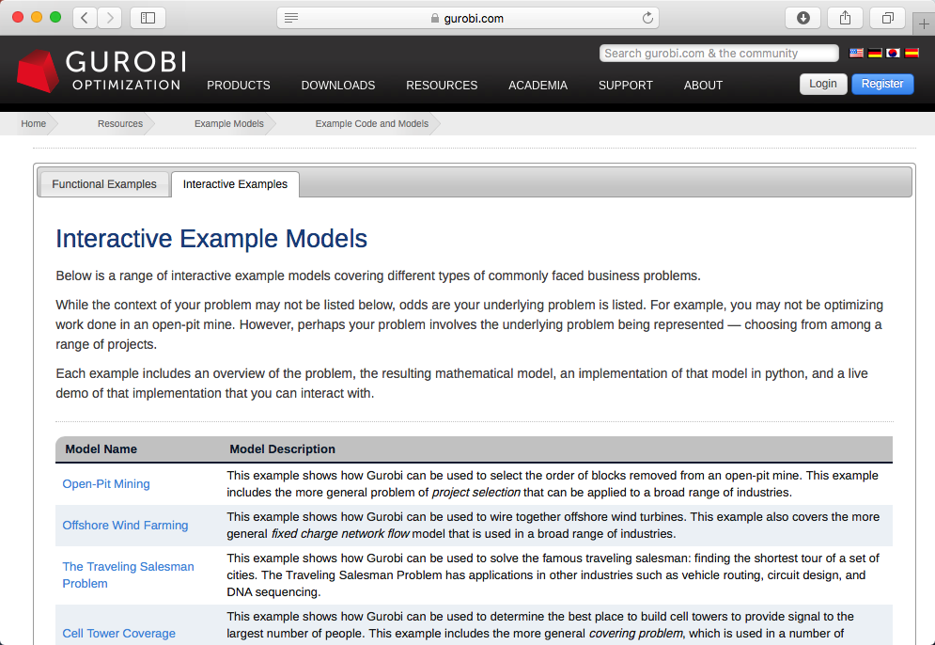
Interactive Examples

Slide 16
Scenario 3: Porting Matrix-Oriented Code
Example: C program which uses CPLEX Callable Library, XPRESS, …
Gurobi's C API supports sparse matrix format
Standard format used by many solvers
Simple arrays represent matrix coefficients and their index positions
Ex: GRBaddconstrs(), GRBaddvars()
Virtually no changes required to existing code
Gurobi also supports advanced features
Callbacks
Advanced simplex routines (querying tableau rows)
…
Must consider some Gurobi-specific modeling features when porting existing code
Gurobi environments
Lazy updates
Attributes

Slide 17
Gurobi Environments
Models are built from an environment
Parameters are set on an environment
Models get their own copy of the environment
Once a model is created, subsequent parameter changes in parent environment are not reflected in model environment
Use getEnv() functions to get the environment from model
Setting parameters in C
Ex: set time limit of 3600 seconds for parent environment
status = GRBsetdblparam(env, "TimeLimit", 3600);
Ex: set presolve level to 2 for model's environment
status = GRBsetintparam(GRBgetenv(model), "Presolve", 2);

Slide 18
Lazy Updates
Gurobi updates models in batch mode
Model creation and updates are efficient
Must call GRBmodelupdate() function to use model elements
Ex: Call after creating a variable before using it in a constraint
May require changes to code for other solvers
UpdateMode=1 parameter setting allows you to use elements immediately

Slide 19
Attributes
Unified system to access model elements
Attributes work the same across all Gurobi interfaces
Attributes refer to model elements
Access via a basic set of get and set functions
Attribute name is specified as a parameter
Replaces many functions used by other solvers
Getting/Setting attributes in C
Use get/set functions by type (int, double, char, string)
Ex: query number of nonzeros in a model
status = GRBgetintattr(model, "NumNZs", &nzs);
Ex: query solution vector
double x[NUMVARS];
status = GRBgetdblattrarray(model, "X", 0, NUMVARS, x);
Ex: modify constraint RHS to 1
status = GRBsetdblattrelement(model, "UB", cidx, 1.0);

Slide 20
Scenario 4: Porting Object-Oriented Code
Example: Java program which uses CPLEX Concert Technology
Gurobi's OO APIs represent models using objects
Objects for variables and constraints
Methods are used to create model elements
Ex: add simple constraint x+y≥1 in C++
c1 = model.addConstr(x + y >= 1, "c1");
All Gurobi APIs are just thin layers on top of same native C code
Must consider same Gurobi-specific modeling features when porting
Subsequent parameter changes in parent environment not reflected in model environment
Java Ex: model.getEnv().set(GRB.IntParam.Presolve, 2);
Must call model's update() method to use elements (unless UpdateMode=1)
Use get/set methods on objects to access attributes
Python Ex: constr.setAttr('RHS', 1.0)

Slide 21
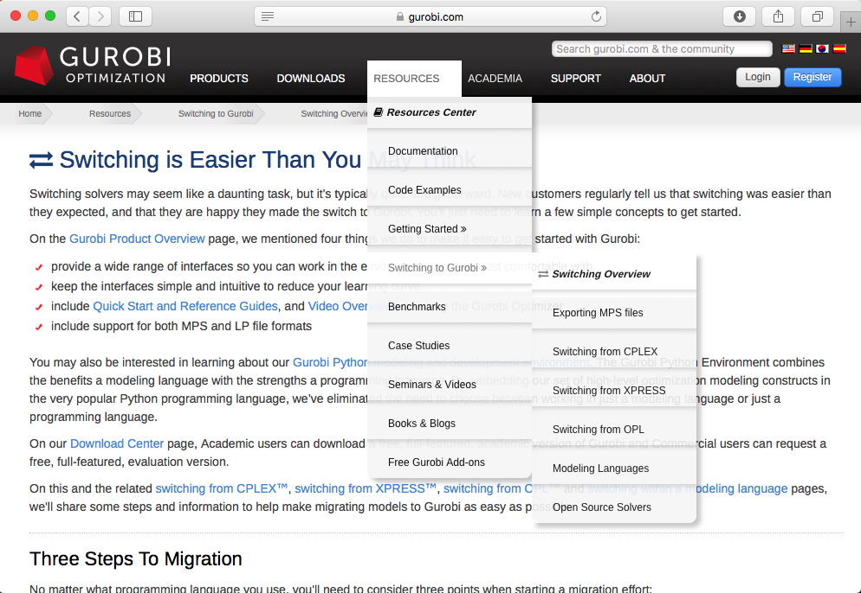
Solver-specific Guidance

Slide 22
Migrating from OPL

Slide 23
Migration Library for CPLEX Concert API

Slide 24
Best Practices, Limitations and Considerations

Slide 25
Questions
Please use the Question box to ask questions to the speaker

